Slide 1


Human vs AI
Detection
NTI Final Project

Slide 2

TEAM MEMBERS
ABDELRAHMAN GALHOM
AHMED ASHRAF
MOHAB ALI
HEND KHALED ALY
ANAN ZEWIL

Slide 3
Introduction
Preprocessing
Contents
BRNN
Transformers
Conclusion

Slide 4
INTRODUCTION

Slide 5
Problem Statement
detection of AI generated vs human text
Academic integrity
Cv evaluation
Fraud detection

Slide 6
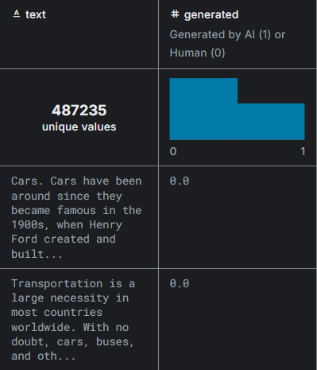
Data overview

Slide 7


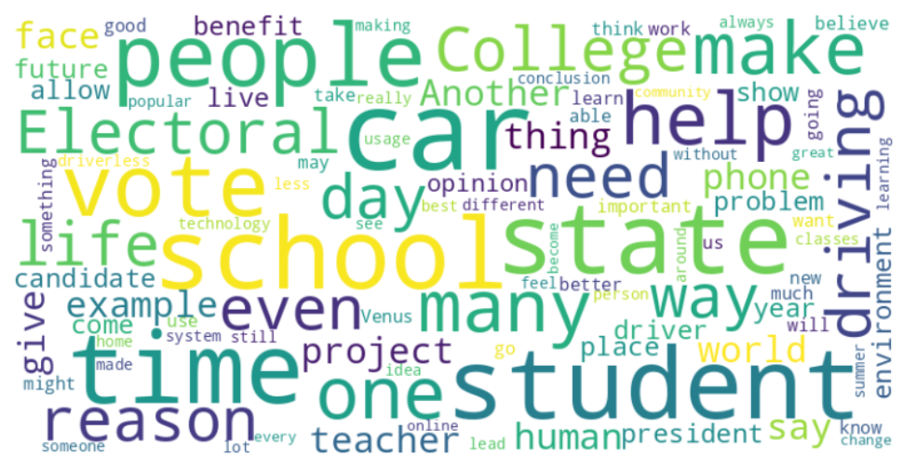
Visualisation

Slide 8
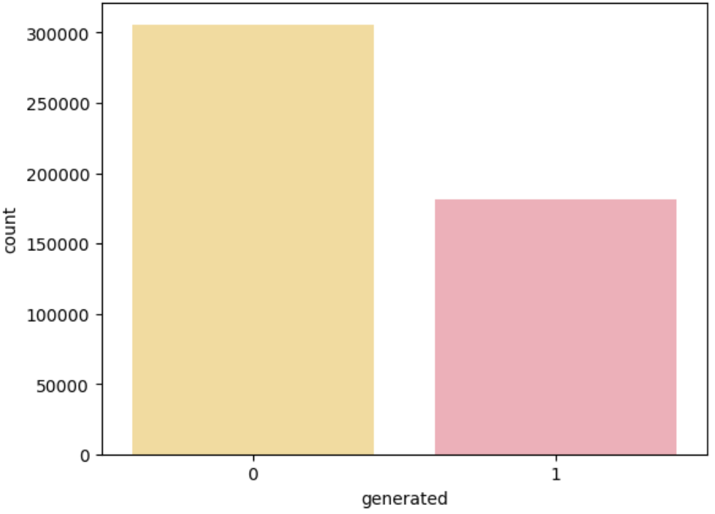
Data distribution

Slide 9
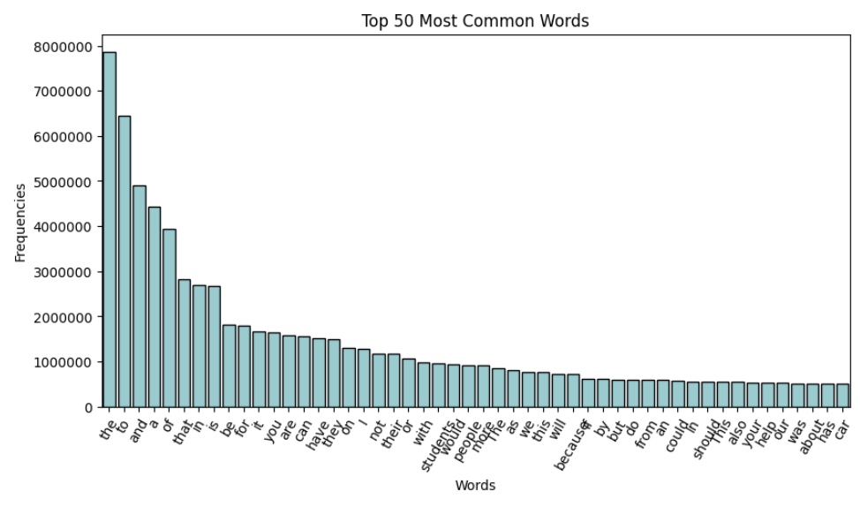
most common words

Slide 10
Preprocessing

Slide 11
*‌Remove New lines and Punctuation
‌*Tokenize
‌*Clean and Lemmatize Tokens:
A list comprehension filters out stop words and lemmatizes the remaining tokens, converting them to lowercase.
‌*Return Processed Text & ‌Check and remove empty lines

Slide 12
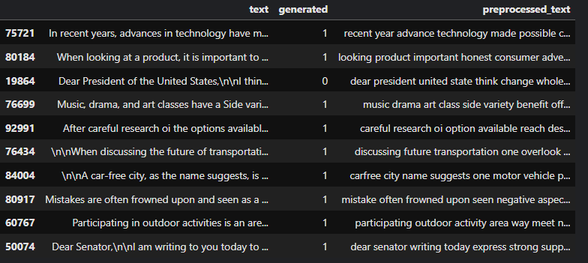
Before
After

Slide 13
Before
After

Slide 14
Text vectorization

Slide 15
tf.keras.layers.TextVectorization
A preprocessing layer which maps text features to integer sequences.
Tokenization: Splits the text into tokens, typically words or subwords.
Vocabulary Generation: Builds a vocabulary from the text data, mapping each token to a unique integer.
Text Standardization: Applies basic text preprocessing like lowercasing and punctuation removal.
Output Format: Produces either a dense representation (e.g., one-hot encoding) or a sparse representation (e.g., indices).

Slide 16
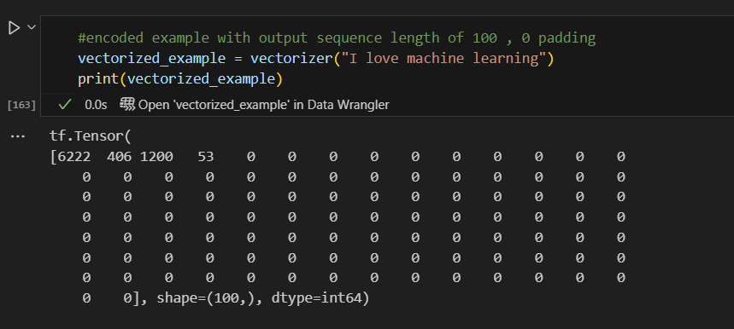
Initialization Parameters
max_tokens: Maximum size of the vocabulary.
output_sequence_length: Fixed length for padded sequences..
standardize: Specifies the text standardization method.
split: Defines the tokenization method.

Slide 17
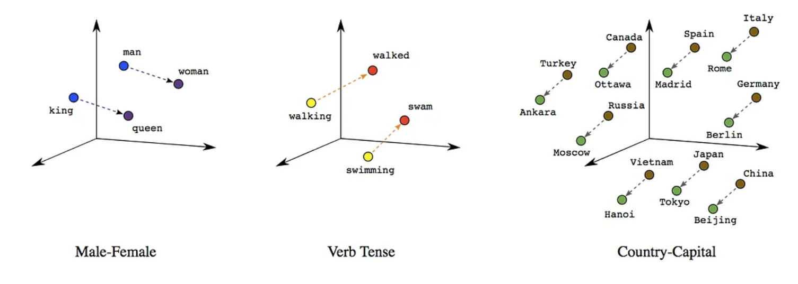
Embedding
Word Embeddings are dense representations of the individual words in a text, taking into account the context and other surrounding words that that individual word occurs with.
The dimensions of this real-valued vector can be chosen

Slide 18
What is RNN?

Slide 19
recurrent Neural Networks (RNN)
A recurrent neural network (RNN) is a deep learning model that is trained to process and convert a sequential data input into a specific sequential data output.
Sequential data is data—such as words, sentences, or time-series data

Slide 20

Sequential Processing
RNNs process data in sequences. For example, given a sentence, the network processes one word at a time. As each word is processed,
the network updates its internal state to capture information about the sequence so far.
how rnn works
Hidden layer
by passing the sequential data they receive to the hidden layers one step at a time. However, they also have a looping or iterative workflow .
give example
Weight Sharing
RNNs use the same set of weights (parameters) across all time steps. This weight sharing makes RNNs well-suited for sequential data, as it allows them to generalize across different positions in the sequence.

Slide 21
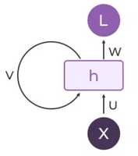
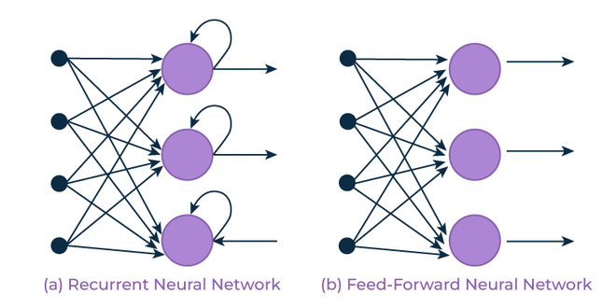

Slide 22
vanishing gradients & short term memory

Slide 23
Long Short Term Memory (LSTM)
Gradients during backpropagation become extremely small at this point, making it challenging for the network to learn from the data. Many RNN versions, such LSTMs, and GRUs, which use gating methods to regulate the flow of information and enhance learning
give example
The basic difference between the architectures of RNNs and LSTMs is that the hidden layer of LSTM is a gated unit or gated cell. It consists of 3 layers that interact with one another in a way to produce the output of that cell along with the cell state.

Slide 24
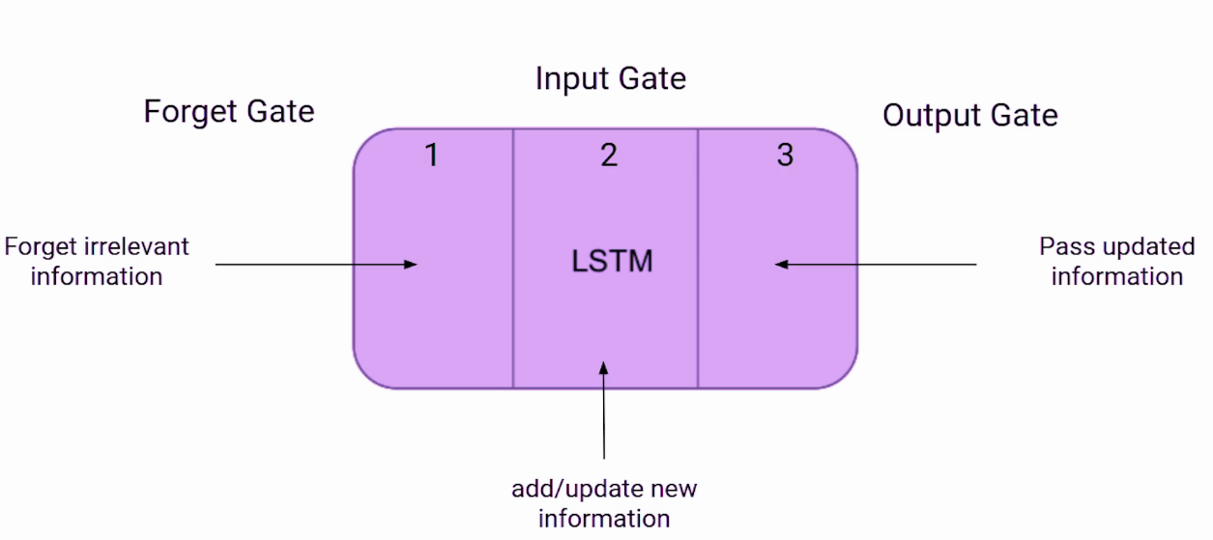
Decides what information from the cell state should be discarded or kept.

Slide 25
Bidirectional Recurrent Neural Network
(brnn)

Slide 26

Bidirectional Recurrent Neural Networks (BRNNs)
An architecture of a neural network called a bidirectional recurrent neural network (BRNN) is made to process sequential data. In order for the network to use information from both the past and future context in its predictions, BRNNs process input sequences in both the forward and backward directions.

Slide 27
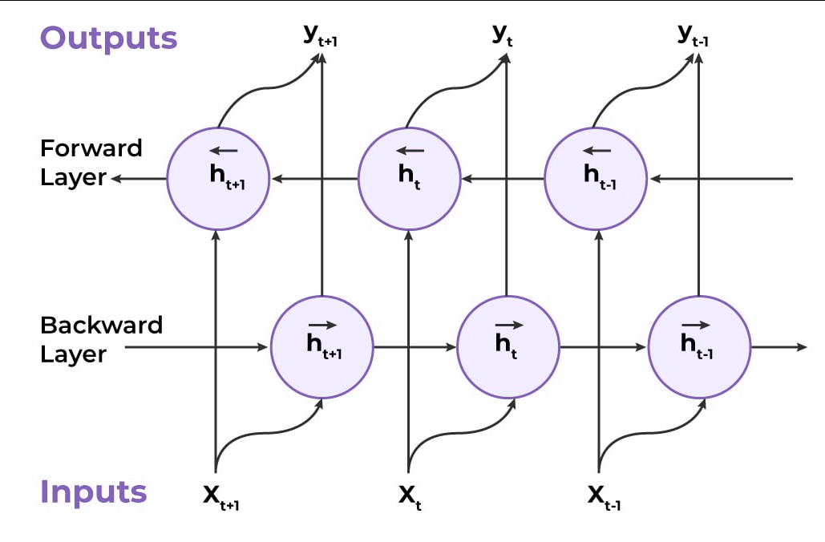

Slide 28
Inputting a sequence
Bidirectional Processing (Dual Processing)
how BRNN
workS
Computing the 2 hidden layers
Determining the output

Slide 29
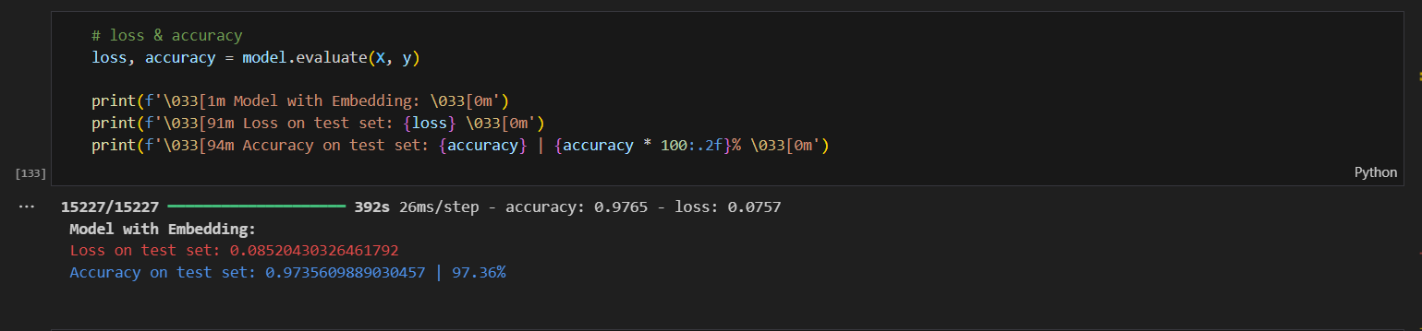
aCCURACY AND LOSS

Slide 30
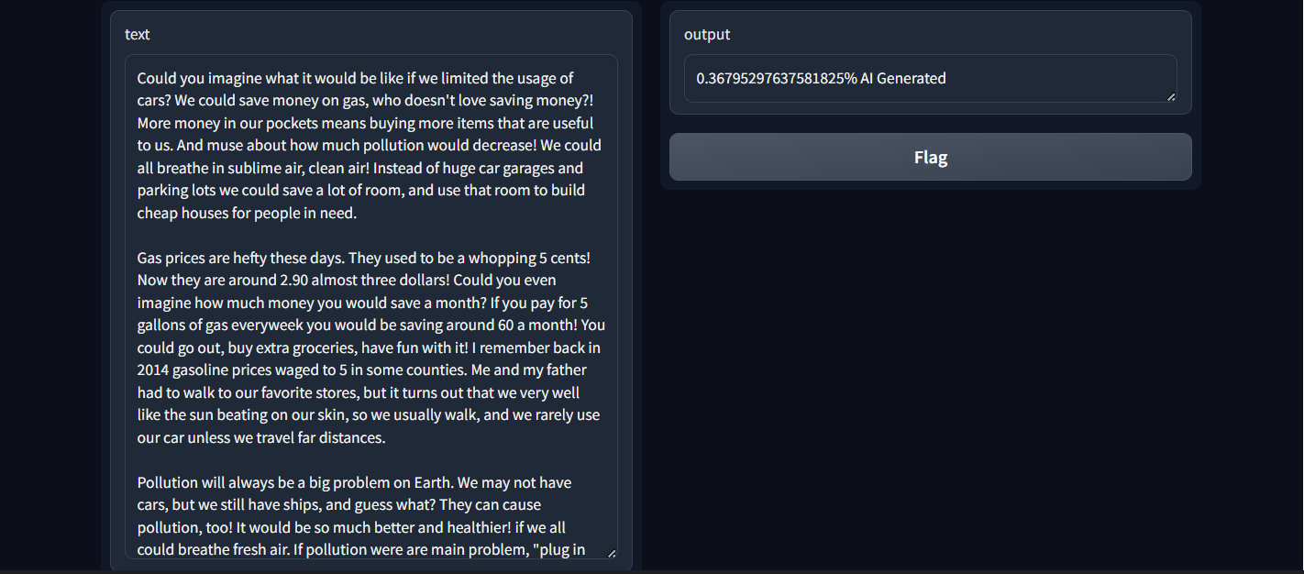
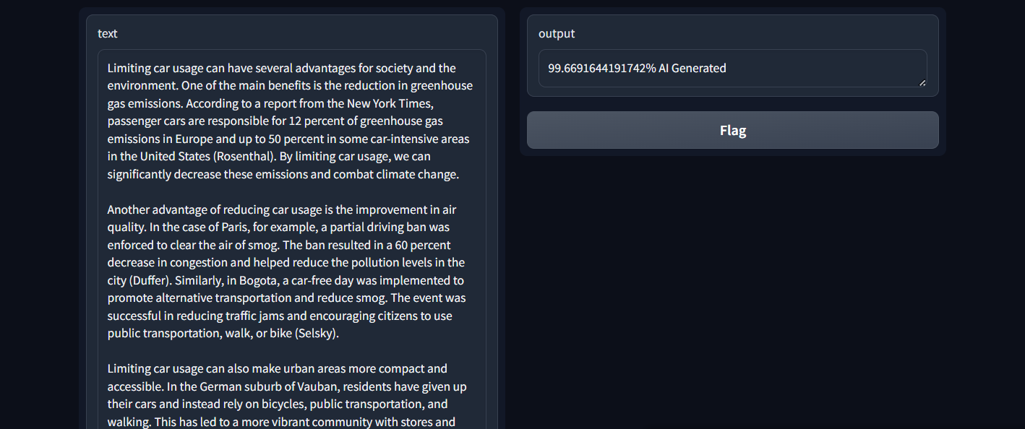
Deployment

Slide 31
Transformers

Slide 32
Transformers
Transformers are a type of deep learning model introduced in the paper 'Attention is All You Need' by Vaswani et al. in 2017. They are designed to handle sequential data, such as text, but unlike RNNs, they rely on a mechanism called self-attention to process entire sequences at once, allowing for more parallelization and better performance on longer sequences.

Slide 33
Self-Attention Mechanism
Parallelization Capability
Characteristics
Use of Positional Encoding
Scalability
Notes:
1. self attention: bysa3d elmodel y-classify elwords el fel sentence 3shan y3rf el most important words, w da by5alena n-focus on the right words w de haga el RNNs struggles feha
2. Parallelization: mmkn ybos 3ala kol el parts bt3t el sentence f nfs l wa2t, 3ala 3aks el rnns bta5od kelma kelma, w da by5ly el transformers more efficient when learning from data
3. positional encoding: transformers may3rfosh el order bt3 el kalemat fel sentence, fa byzwdo extra information lel words 3shan yshow their position, w da by5ly el model ye3rf el correct order bt3 el words
4. Scalability: can handle large amounts of data, y3ni by2dr yefhm w y-learn from information kter w da by5aly el predictions very accurate

Slide 34
Transformers consist of an encoder-decoder architecture, where the encoder processes the input sequence and the decoder generates the output sequence
Encoder :
Takes input embeddings and applies self-attention and feed-forward layers.
Multi-Head Self-Attention allows the model to focus on different parts of the input sequence simultaneously.
Architecture
Decoder :
Uses the encoder’s output and the previous target sequence to predict the next word in the sequence.
Incorporates masked self-attention to ensure that predictions depend only on previously generated outputs.
Notes:
transformers bttkwn men 2 main parts: encoder and decoder
encoder: by5od el input (Sentence) w by-process it
decoder: bya5od el processed information w by-generate output based on the processed input
allows the transformer to handle complex tasks zay translating languages, summarizing texts, generating new sentences, and so on

Slide 35
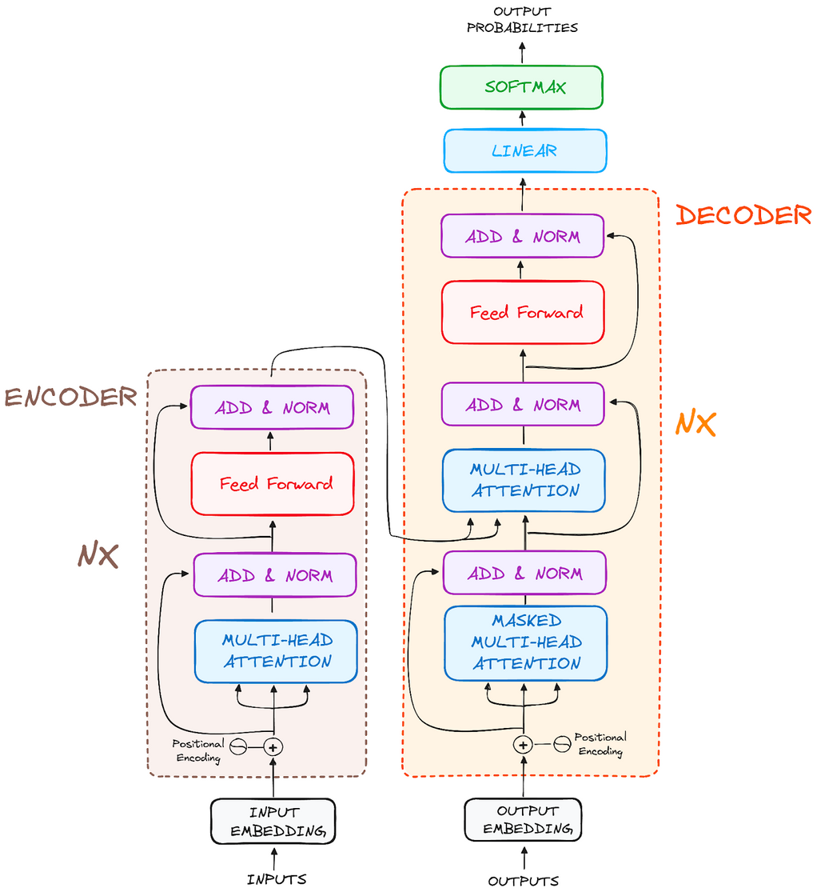
Notes:
1. encoder: bytkwn men several identical layers aw blocks (6 to 12)
Nx de y3ni el block el odamna da bytkrr N times
- input embedding: by7wl el input tokens (words) l dense vectors of fixed size. 3shan el model ye2dr yefhmha
- positional encoding: add order of words
- multi head attention: by5ly el model yrkz 3ala parts mo5tlfa mel input sequence simultaneously
- add and norm: (op of multi head attention + lel original input), b3d keda bn3ml normalization, w da by5aly el training asr3 w more stable
- feed forward: neural network, bt3ml more processing lel info el tl3a mel attention mechanism
- add and norm tani (op of feed forward + ip of it) then normalization
2. decoder:
bytkwn men several identical layers aw blocks (6 to 12)
Nx de y3ni el block el odamna da bytkrr N times
- o/p embedding: by7wl el output tokens (words) l dense vectors of fixed size. 3shan el model ye2dr yefhmha
- positional encoding: add order of words
- masked multi head attention: heya heya el multi head attention bas feh mask applied leha 3ashan y5ly el model yst5dm words it has already generated or seen to predict the next word, ana mesh 3yzah y-cheat 3an tare2 eno ylook ahead at future words
- add and norm: heya heya
- multi head attention: how howa encoder bas el marady by-integrate info from input sequence w el sequence el hslo generation so far
- add and norm: heya heya
- feed forward: neural network, bt3ml more processing lel info el tl3a mel attention mechanism
- linear: neural network layer, fully connected dense layer, maps decoder output (sequence of vectors, kol vector by-represent info about word/token at that position in the sequence) to the vocabulary size (total number of unique words/tokens in the model's vocabulary)
- softmax: convert op from linear layer (raw scores) into probabilities, model can decide which word to pick next.
- op probabilities: final op of decoder is a probability distribution. For each word position in the sequence, the model creates a "menu" of all possible words, with each word having a probability (or chance) of being the next word. It then picks the word with the highest probability from this "menu" as the output for that position.

Slide 36
Training:
Data: Tokenized Sequence of input
Forward Pass: Encoder processes input, decoder predicts next token.
Training
vs
testing
Loss: Computed with cross-entropy, optimized with Adam.
Testing:
Input: New sequences fed into the trained model.
Output: Predictions compared against ground truth.
Evaluation: Performance measured using accuracy, F1-score, etc.
Notes:
- training: data , forward pass
loss: cross entropy loss, Measures how well the predicted tokens match the actual tokens. kol lama el loss 2alet kol lama el prediction kan ahsn
- testing:
input: new text sequences
output: model generates predictions
evaluation: compare predictions with the actual values, 3shan n2dr ngeb el accuracy, f1 score and so on

Slide 37
High parallelization
Superior performance on complex tasks
Advantages and
Challenges
Scalability to large datasets
Computationally expensive
Inference Speed
Complex Architecture and Training Process

Slide 38
Applications and Uses of Transformers
NLP:
Machine Translation (e.g., Google Translate)
Text Summarization
Sentiment Analysis
Text Generation (e.g., GPT series)
Computer Vision:
Image Classification (e.g., Vision Transformers)
Object Detection
Image Generation
Other Fields:
Speech Recognition (Siri)
Recommender Systems

Slide 39
Bidirectional Encoder Representations from Transformers
(bERT)

Slide 40
Bidirectional Encoder Representations from Transformers
(bERT)
It is a pre-trained deep learning model developed by Google. It leverages the Transformer architecture to process text in both directions—left-to-right and right-to-left—simultaneously. This bidirectional approach allows BERT to capture context from all parts of a sentence, making it highly effective for various natural language processing tasks such as text classification, question answering, and language understanding.

Slide 41
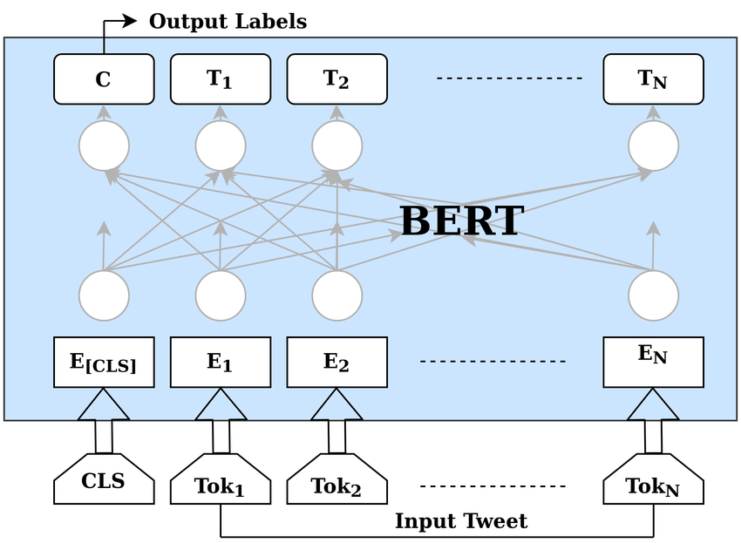

Slide 42
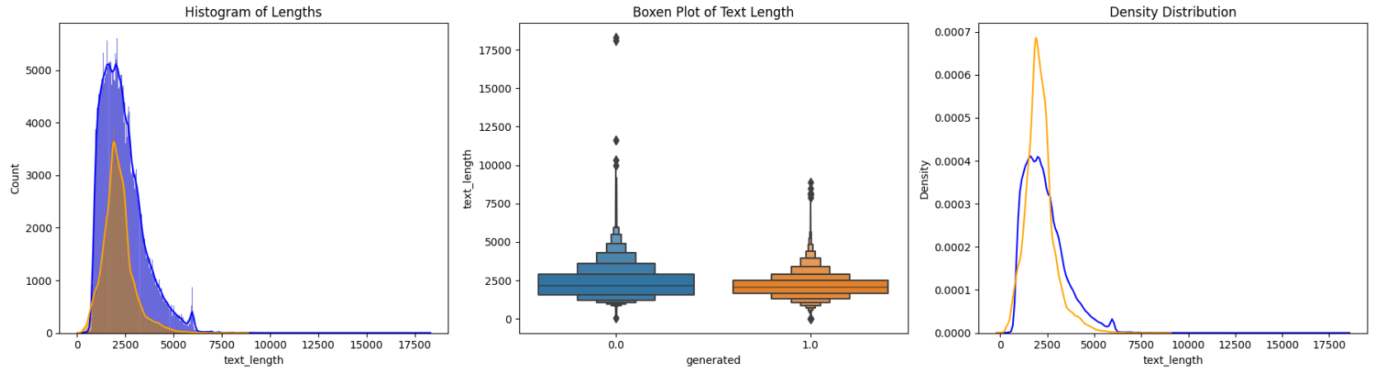
Analyzing Text Length Differences Between Human and AI-Generated Content

Slide 43
Data was split into training and validation of ratio 90/10
Data Splitting and Tokenization
Employed BERT’s tokenizer to preprocess text
Encoded texts into fixed length sequences for input into the model

Slide 44
Used BERT for sequence classification with two output labels (Human-written or AI-generated).
Model
Architecture
Model compiled with Adam optimizer and Sparse Categorical Crossentropy loss.
Implemented early stopping to prevent overfitting

Slide 45
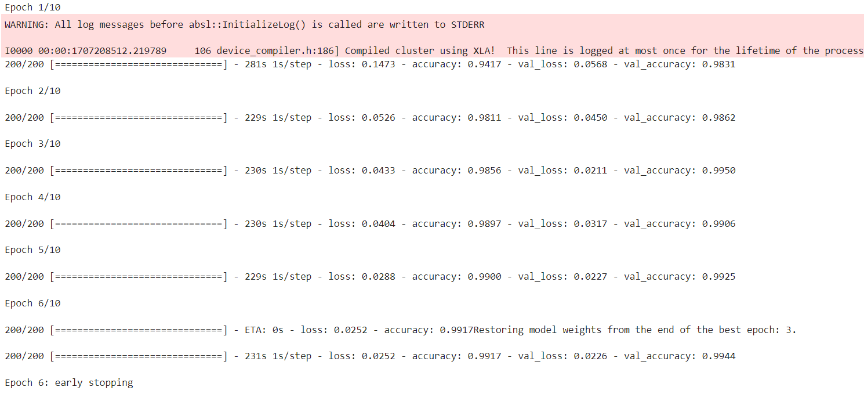
Model Training, Prediction and Evaluation

Slide 46
Conclusion

Slide 47
FInal Results
P.O.C | RNN | Transformer
Accuracy | 97.65% | 99.17%

Slide 48
Thank You

